Slide 1
Re-Energizing Your School Boards
Carol Cimino, SSJ, Ed.D.

Slide 2
What to Keep in Mind
Many new pastors are not familiar with the nature of the Catholic school board.
Many new administrators (and pastors ) are not convinced they need a board.
Parents are unsure about what the board does vis a` vis the HSA.
Ownership and governance must be kept in mind while there is diocesan planning.

Slide 3
Some more considerations:
Catholic school boards are a relatively new phenomenon (50 years)
Many dioceses keep a controlling interest in the limits and latitudes of school boards.
Some boards have exceeded their authority.
The concept of a synodal Church is new and boards are a good way to convey that.
There is a growing need for collaboration and partnerships in Catholic education.

Slide 4
Recent Developments
Move to boards of limited jurisdiction-or back
Move to centralization
Move to board ownership among religious order-owned schools.
More sophisticated, vocal parents/parishioners.
More centralization/consolidation of Catholic schools has led to centralization of boards.

Slide 5
Why Do This Now?
1. COVID may have made many boards inactive.
2. There has been a great deal of turnover in board membership (or not).
3. By-laws may have become extinct, irrelevant, outdated.
4. New administrators may not be familiar with the nature/purpose of a Catholic school board.
5. Crises that gave the board purpose may have passed.
6. Consolidations, closures, may have derailed the board’s sense of purpose.
7. Isolation can be enervating.
8. Accreditation processes demand active, effective boards

Slide 6
High Performing Boards
What makes them tick?

Slide 7
Characteristics
Understand Catholic identity
Understand their own spirituality
Strive for excellence
Continue to move forward
Focus on their mission
Make many alliances

Slide 8
Entrepreneurial Spirit
Know the importance of keeping the financial picture stable
Keep developing programs and services
Aggressively seek new markets

Slide 9
Competitive Advantage
Keep providing solutions
Understand threats and opportunities
Maintain a high profile even when other boards are pulling in

Slide 10
Strategic Direction
Have a strategic plan
Make the plan the work of the board and its committees
Build coalitions and attract volunteers to get the plan activated

Slide 11
Golden Handcuffs
Make board membership highly valued
Attract and retain members by giving them the opportunity to make a difference

Slide 12
Committee Effectiveness
Get rid of dormant or needless committees
Attract new non-board members
Investigate means to activation and effectiveness
Consider task forces
Clarify committees’ purposes and mission
Maintain active, effective committees that really work

Slide 13
Mission-driven
Occasionally re-study the mission of the school
Understand Catholic identity
Float the mission out to constituencies
Measure mission effectiveness
Understand their own mission

Slide 14
Leadership Development
Study by-laws for rules of succession
Cultivate members with leadership potential
Make the membership committee effective

Slide 15
Future Focus
Direct constituents to the strategic plan, future events
Keep the board’s focus on what’s ahead, not what’s past

Slide 16
Collaborate
Work with other entities involved in the school
Create/sustain partnerships with other schools, the local district, service agencies, civic community, business community

Slide 17
So, How to Energize?
Update current board members on nature of boards
Reactivate board committees
Conduct annual in-service
Review by-laws
Ritualize board membership entrance
Pay attention to member involvement

Slide 18
How to Energize
Conduct joint board meetings w/other schools
Publicize board successes
Formalize an orientation process
Give them something to do
Explore the spirituality of the board
Train board chairs, secretaries

Slide 19
Energize Your Boards
Do worthy inservice
Emphasize ministerial nature of membership
Activate committees
Train board members on Catholic identity
Include board minutes on school website

Slide 20
Energize Your Boards
Show appreciation
Train pastors, administrators
Make board members visible, part of other school activities
Review board agendas, minutes
Host annual board retreat
Help boards to assess their effectiveness
Set aside time for annual goal setting

Slide 21
Currently:
Boards need to tackle strategic planning, accreditation;
Boards need to craft/recommend policies re:
Crises
Artificial Intelligence
Current social issues
Catholic identity
Boards need active, operational committees;
Boards need to explore Catholic identity;
Boards need to re-dedicate their purpose;
Boards need to clarify relationships.

Slide 22
Catholic School Boards are Gifts
Ensure that membership reflects by-laws
Utilize boards under appropriate activities
Make sure they meet
Help pastors, administrators understand purpose and use of boards
Cultivate members; have a membership committee
Emphasize ministerial nature
Provide adequate inservice
Honor their service

Slide 25
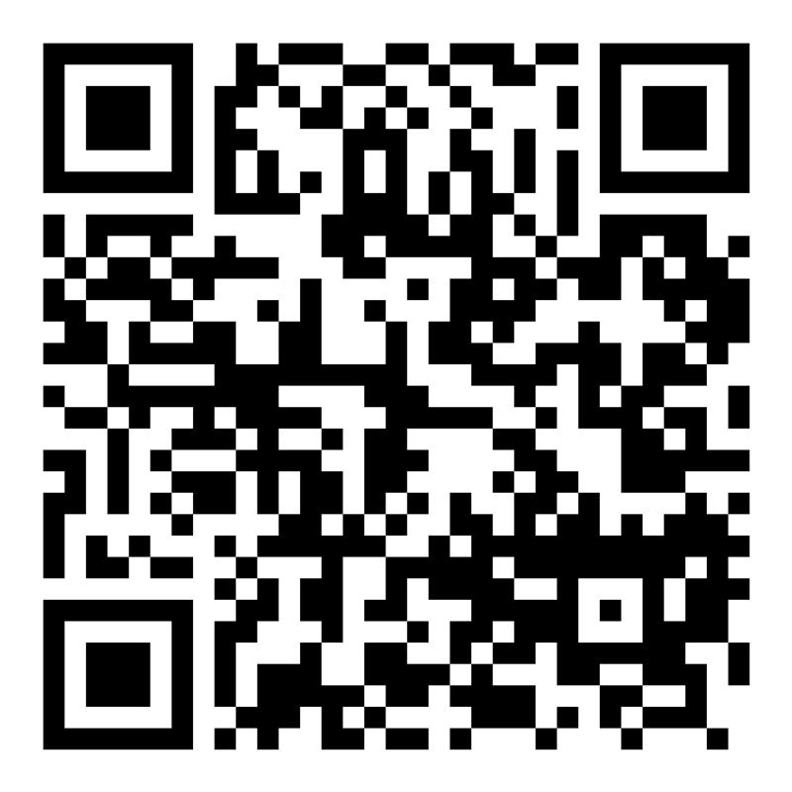
Evaluate This Session
Please help by evaluating this session. Visit the link below or scan the QR code.
Thank you for your valuable input!
https://whova.com/portal/surveys/catho_202411/session_surveys/

