Slide 1
Coping With Post-COVID Parents

Slide 2
Class Picture, Class of 2020
What we learned and how we need to use that.

Slide 3
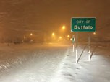
What People Think…

Slide 4
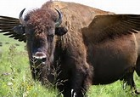
Buffalo: Home of the Buffalo Wing

Slide 5
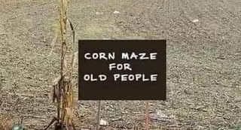

Slide 6
What’s in Here:
What parents were like before COVID
What happened when the world shut down
What happened to kids
What happened to teachers
What happened to parents
What it’s like now
How to use all this to cope with now.

Slide 7
2025 Kindergarten Class List
Covida Cottonella
Novida Charmina
Qurarantino Chlorino
Virino Curfewto
Sociala & Distancia Pandemico
Maski
Purella

Slide 8
Today’s Climate
Divisive
Distrustful
Tired
Anxious
Mobile

Slide 9
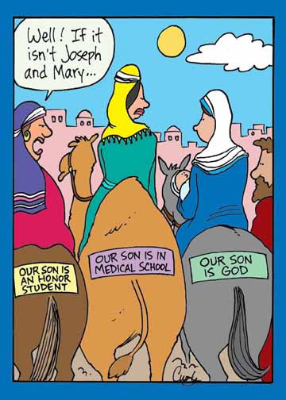

Slide 10
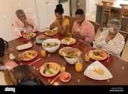
It’s Not Easy Being a Parent
Concerned about uncertainty
Angry
Health, welfare of their family
Frustrated by distance learning
Financial woes
Workplace uncertainties
Balancing time, energy

Slide 11
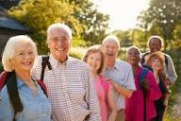
Families
Multigenerational
Coping with the economy, lifestyle, spending habits
Job instability
Hardship on mothers
Trying to plan for the future
Pressures of culture

Slide 12
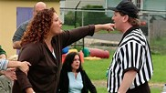
Remember when..
Tigers
Helicopters
Dry Cleaners
Snowplows

Slide 13
COVID made some things worse:
Intergenerational households
Instability of the whole societal structure
Work issues
Fear, anxiety
Effects on children and
Teens
Stresses on households

Slide 14
How Hard Was It?
NY Times: May 8, 2022: “Remote learning during pandemic was a failure, study finds.”
On average, students, who by 2020-21 were back in school, lost about 20% of math learning
Students who stayed home 2020-21 lost about 50% of learning.
The COVID closures reversed earlier gains for minority children.
Evidence suggests that these reversals were avoidable. Officials said they were closing schools to protect children; the effect was the opposite.

Slide 15
Technology Has Contributed…
It’s free/cheap
Possibility of anonymity
Support for rants
Avoids responsibility, actual confrontation
Can be sent/shared with anyone

Slide 16
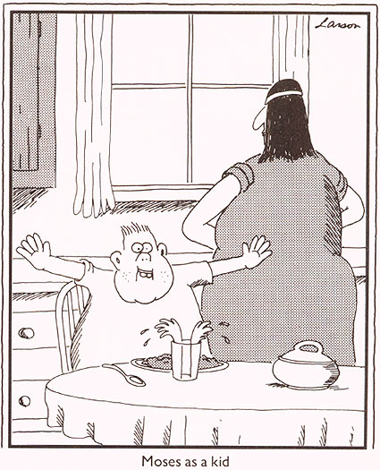
What's more...
Go right to the top
No stress
involve schools in family situation
Vehement in protecting
Want to know...

Slide 17
During COVID
Frustration on the part of parents
Watched their children change
Felt powerless, answerless
Couldn’t participate in rites of passage
Lack of supportive community
Difficulties with technology
Interference with work

Slide 18
Return to the “new normal”
Uncertainty: will it happen again?
What we learned
More home-schooling
Fears of mass shootings, cyber-violence, the unforeseen
Fears of return for students with special needs, bullied and the bullies
Pressure on principals to communicate, implement policies that change daily
Wariness: should I keep my child home?
Trying to catch up
Children’s resiliency: can’t we just go back to where we were?

Slide 19
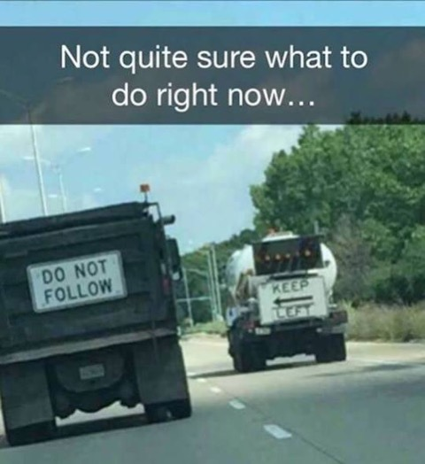

Slide 20
And Now What?
We need to maintain the community of the school, “be on the same page”
We need to work on resiliency of everyone
We need to be patient
We need to support each other, create networks of support
We need to value the mission of the Catholic school
We need to call on our support groups to help

Slide 21
Some Practical Steps
Meet with parents to give them some practical tips for keeping children engaged.
Regularly send out updates on curriculum and instruction
Ask them: how is this working? How can we help?
Focus on the community aspect of the school: rites of passage, celebrations, anniversaries, special observances.
Have some practical in-service for parents on technology

Slide 22
Some More Practical Steps
Provide a safe forum for parents to interact with teachers/staff
Provide up-to-date bulletins on health and other issues
Give teachers a forum with which to interact with parents
Give them something to do
Assure parents, be supportive and appreciative
Take bullying seriously
Respond appropriately to issues.

Slide 23
Even MORE Practical Steps
Utilize your board/council
Emphasize communication
Use opportunities to get to know parents: e.g. coffees, small-group meetings
Take every effort to build community: e.g. potlucks, new parent welcome, food truck roundups, prayer opportunities, sacramental programs, tips for helping children learn, etc.

Slide 24
If you miss the problem, you miss the solution

Slide 25
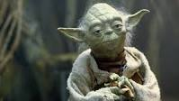
In the words of Yoda: Do or do not; there is no try

Slide 26
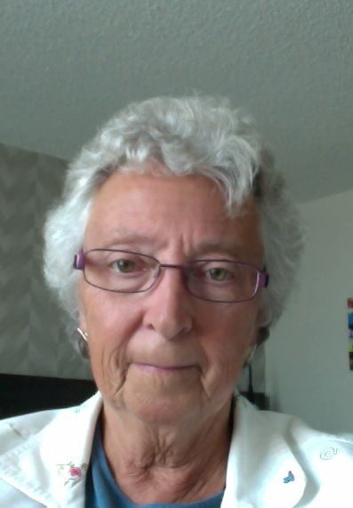
Carol Cimino, SSJ, Ed.D.
518-577-6777
carolcimino795@gmail.com
srcarol.com

