Slide 1
The Eucharistic Revival
What is it? What does if have to do with me? What does it have to do with teaching?

Slide 2
THE INFLUENCE OF THE NARROW GAUGE RAILWAY ON THE EUCHARISTIC REVIVAL IN OUTER MONGOLIA 1903-1911

Slide 6
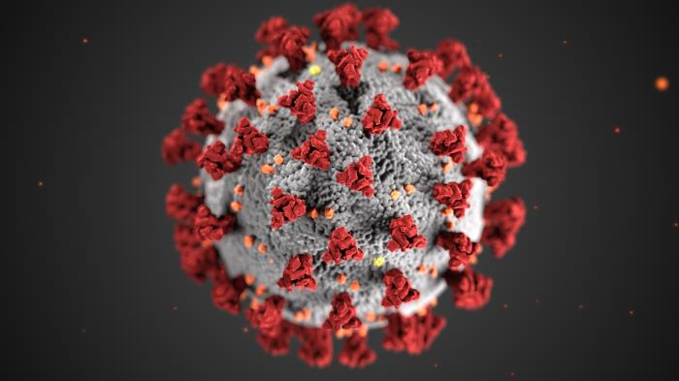
Kindergarten Roster: 2025
Charmina
Covida
Quarantina
Purello
Cottonello
Sociala & Distancia
Pandemico
Class Photo

Slide 7
What’s in Here:
Definition
Purpose
Calendar
Implications for teachers
Some practical steps

Slide 8
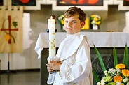
Eucharistic Revival:
A three-year effort to reignite:
Knowledge of the nature of Eucharist
The Eucharist’s place in our lives as Catholics
The influence of Eucharist on issues of concern to young people
Excitement, sense of belonging, to the Catholic Church

Slide 9
Why Now?
Church battered by scandal, doubt
Recovery from the pandemic lockdown
People of God beset by COVID and its aftermath
Discord in the culture
Absence of organized religion in the lives of many
Fear of global forces
Lack of Faith among Catholics (31% believe in True Presence)

Slide 14
When COVID hit:
Churches closed; no access to Eucharist
People started “attending” virtually
Since the re-opening, the Catholic Church has lost 20% attendance (according to Cardinal Dolan)
People perceive that “virtual” is equal to “actual”

Slide 15
Clearly there is Cause for Concern
Children who attend Mass regularly do so because their parents take them.
More and more, parents feel that the Catholic school is a substitute for weekend Mass attendance
Weekend Mass attendance does not take precedent over other weekend activities.
More and more children in Catholic school are not Catholic (20.3% non-Catholic)

Slide 16
Our Concerns as Educators
Catholic identity of the school is essential
We are tasked with training and inspiring the Church of the future.
We are also tasked with teaching the tenets of the Catholic Church
We have a responsibility to partner with parents in the passing on of the Faith
We have the responsibility to model and teach the primacy of the Eucharist

Slide 17
The Calendar
Began Feast of Corpus Christi, 2022
6/11/2023-7/17/2024: Year of Parish Revival
Parish-based activities, events, missions
7/17/2024-7/21/2024: National Eucharistic Congress, Indianapolis
Gathering of the Faithful on a national level to celebrate the mystery of the Eucharist
7/21/2024-Pentecost, 2025 Year of Going Out on Mission
-Commissioning of the laity to live the mystery of the Eucharist and to spread the Good News.

Slide 18
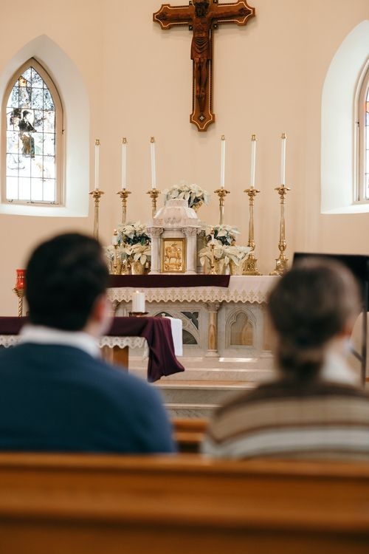
Parish Activities
Targeted readings
Special liturgies
Testimonials
Resources

Slide 19
The Eucharistic Congress
100,000 expected
Talks, Discussions
Lessons for Programs
Networking
Availability of Resources
Experience

Slide 20
Year of Mission
Doing Eucharist: this is
Our opportunity to
Teach the awesome
Beliefs about the
Sacrament of the
Eucharist.

Slide 21
What Do We Teach Children About the Eucharist?
The Eucharist is Jesus’ best and most lasting gift to us: the gift of himself
The Eucharist unites all Catholics in the one belief in Christ’s offering of himself
The Eucharist is truly the body and blood of Jesus, his whole being. It is not a symbol or a memorial.
The Eucharist is nourishment for our soul, just as food nourishes our bodies.

Slide 22
What Do We Teach Children About the Eucharist?
Jesus loves us so much that he gives the best gift-himself- to us.
When we partake of the Eucharist we become more like Jesus.
Although Jesus is with us always, our reception of Holy Eucharist allows us a special closeness to Jesus.
Jesus gave us the Eucharist at the Last Supper when he said, “Take and eat; this is my body, this is my blood.”

Slide 23
Practical Applications for Schools
Different aspect of Eucharist as a monthly theme: e.g. Eucharist as Gift, Eucharist as Nourishment of the Soul
Use of Resources on-line, e.g. movies (Soul Food-for adults only), podcasts, TV (Blue Bloods)
Testimonials from parish leaders. E.g. memories of First Communion
Introspective prayer on the presence of Jesus

Slide 24
More Practical Applications
Send material home to parents to make them aware of the movement
“Pass the cup”
Visit a place that makes communion wafers
Share stories of saints’ devotion to Eucharist.

